Slide 1

ANALYSIS OF LAYOFF IN THE TECH INDUSTRIES FROM COVID 2020 - 2022
“A presentation to the technological and financial companies”
Project Done By
Vishnu Priya Ashok Kumar

Slide 2

Table of Contents
Understanding Data
Method of identifying and analyzing data
Executive summary
Analysis approach using CRISP-DM
Key insights
Recommendations
Appendix

Slide 3
Understanding Data
Layoff dataset concentrates on tech companies across all Industries
1415 companies from 55 countries were employed in the research
Funding stage was grouped into various stages
Seed funding – The first financial support a company gets. Investors invest in a great idea. Usually from family and friends
Series A – follows seed funding. However long-term goals in generating profit are expected from the investors. Funds raised vary from $2 to 15 million
Series B – Comes after Series A. They are used to grow businesses further. Funding in this stage is for businesses with valuations of $30 to $60 million
Series C – The funding supports successful businesses to double profits. Like merging with other businesses or buying off companies or increasing branches and outlets
Series D, E, F, G, H, I, and J – Are various stages of funding that most companies don’t go through due to financial expectation
IPO (Initial Public Offering) – Is when a private company sells stock to the public to generate more funds. For most companies, this comes after Series C
Private equity – Is an investment partnership with matured companies. Private equity firms manage the portfolio of companies to increase their worth.
Acquired - Refers to purchasing of majority of shares of another company to control the operations and the assets.
Unknown - The funding source is not stated.

Slide 4
Method of identifying and analysing data
Data was obtained from https://www.kaggle.com/datasets/swaptr/layoffs-2022
Cleaning and manipulation of data were processed using Python-Jupyter Notes
Analysis and dashboard were created using Power BI and Python-Jupyter Note

Slide 5





Executive summary
From 2020 to 2022, a total of 236071 individuals were laid off from tech companies all over the world.
In 2020 – 80968
In 2021 – 15023
In 2022 – 140080
The total funds raised by Tech companies came mostly from
IPO
Unknown sources
Series H
Core Values
1415 Companies
28 Industries
55 Countries
161 Locations
15 Funding Stages

Slide 6
Analysis Approach using CRISP-DM
Business understanding – Having a good understanding of the objectives and requirements of the business
Data understanding – Collecting data and familiarizing with data to identify how data needs to be presented for manipulation
Data preparation – Cleans and converts data to a useful form
Modelling – Applies the appropriate modelling techniques to extract quality information that aligns with the business cause
Evaluation – Assessing results generated using various parameters
Deployment – Submitting and presenting outcomes to the clients

Slide 7
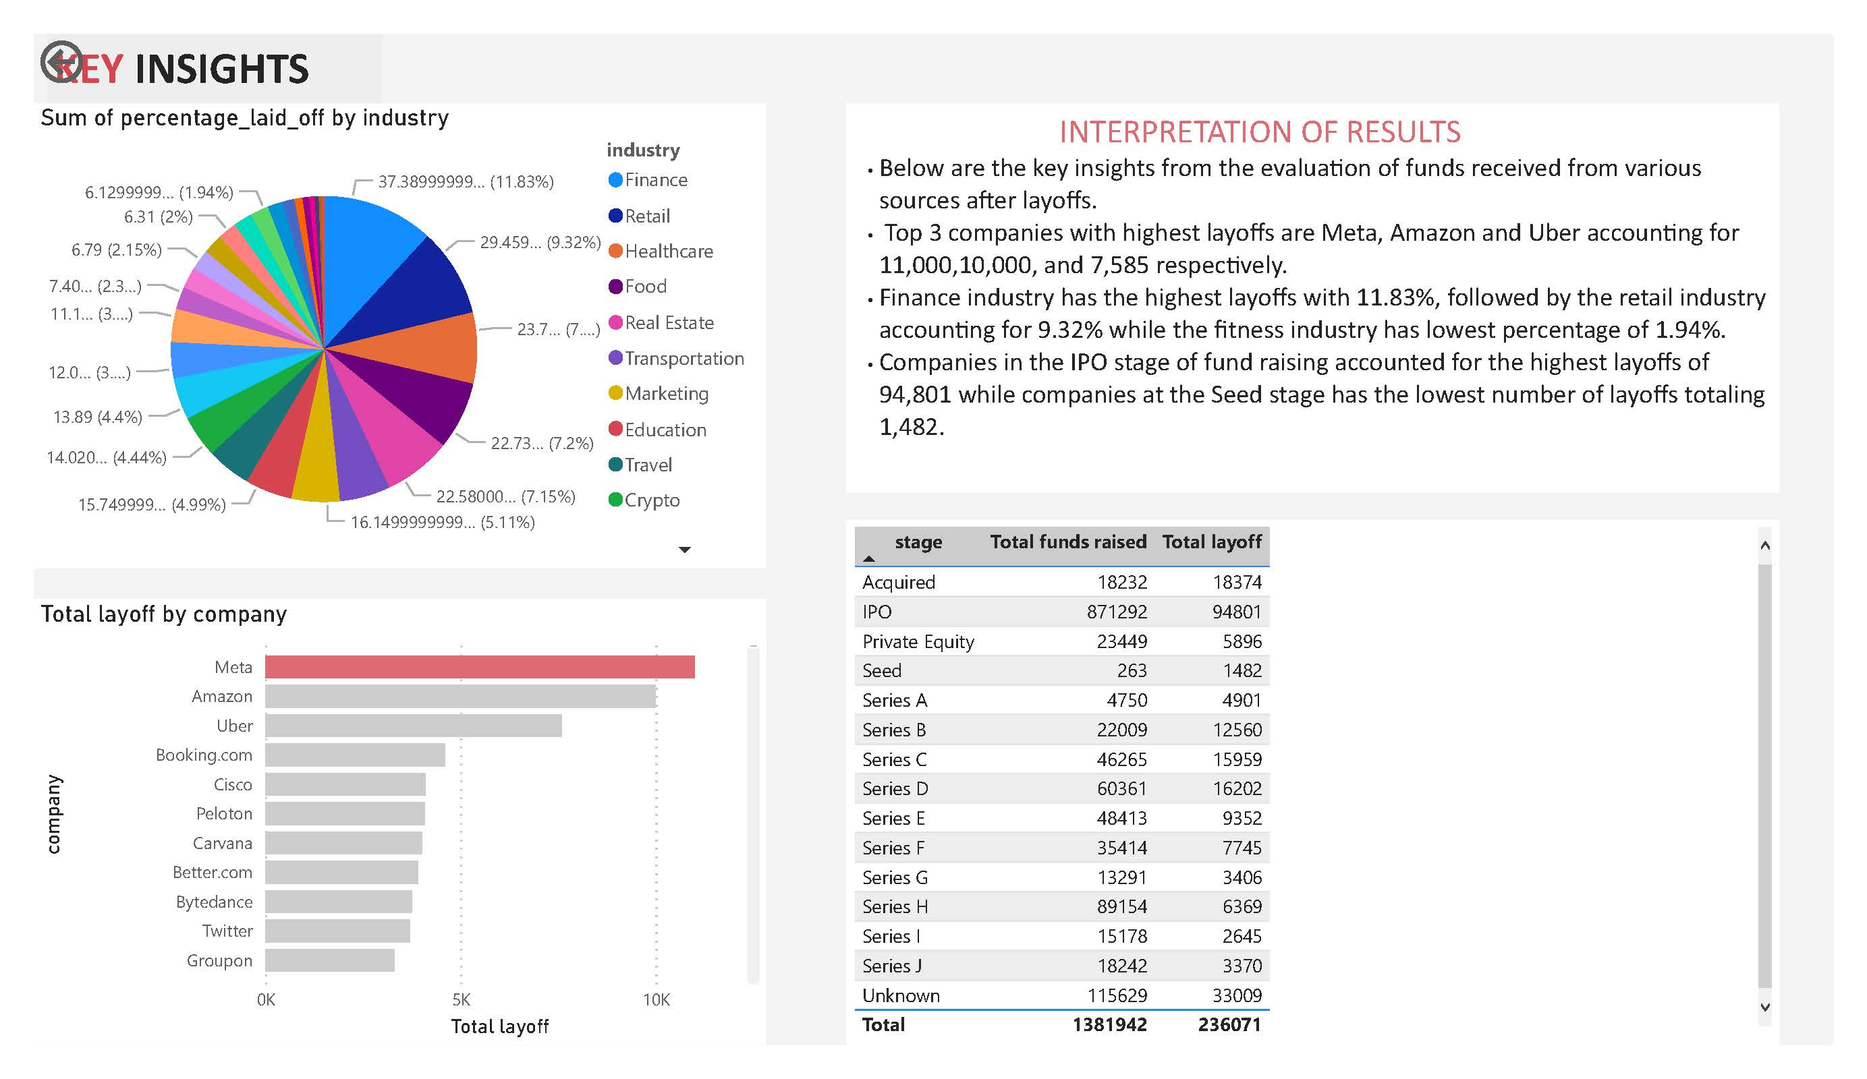
Key insights

Slide 8


Recommendations
The unpredictability of the pandemic reveals that tech companies should invest in financial officers and firm that will advise them on how best to invest and how quickly it's firms can expand.
Tech companies should encourage remote work. This will eliminate the need for the brick and mortar stores which takes up a large amount of capital to set up.
Employees laid off should be supported by their previous companies by being available to grant letter of recommendation and validate employment history as a show of goodwill

Slide 9
Appendix

Slide 10
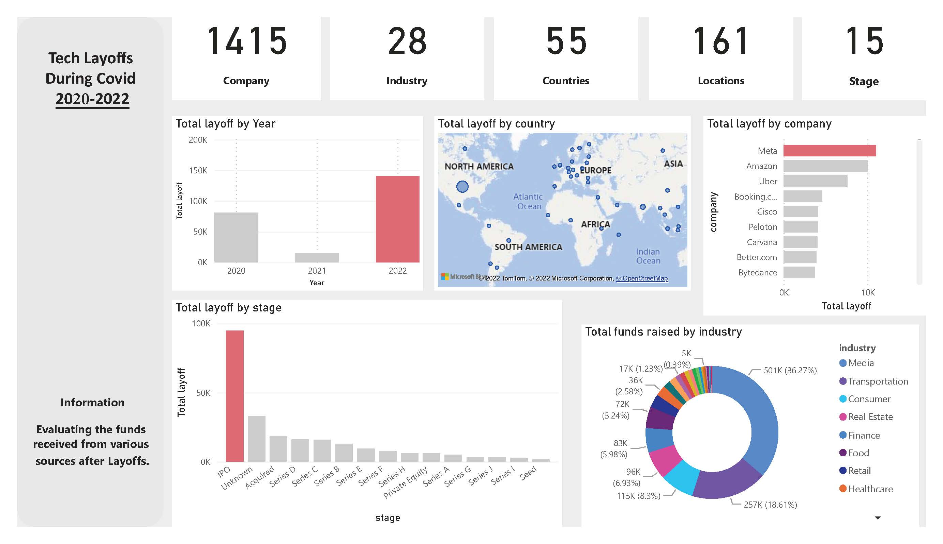
Appendix 1 - Dashboard

Slide 11
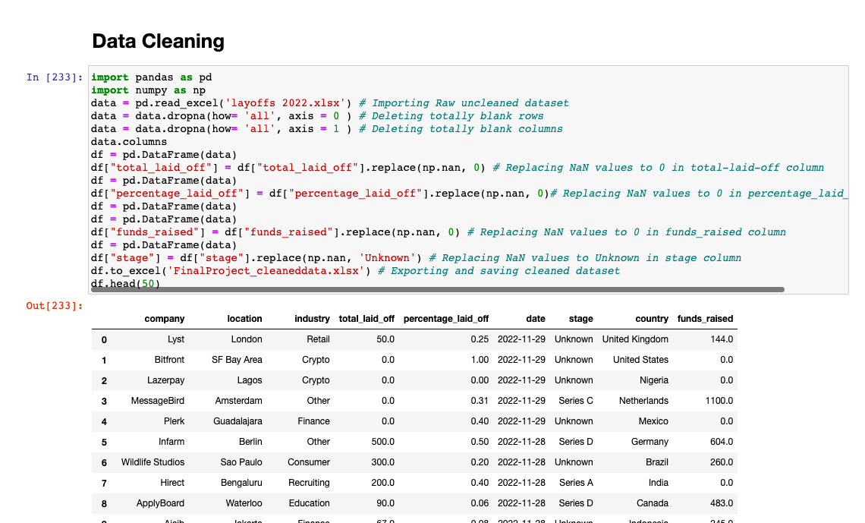
Appendix 2 - Data Cleaning
Raw dataset is cleaned by replacing NaN values in each column and cleaned dataset is exported

Slide 12
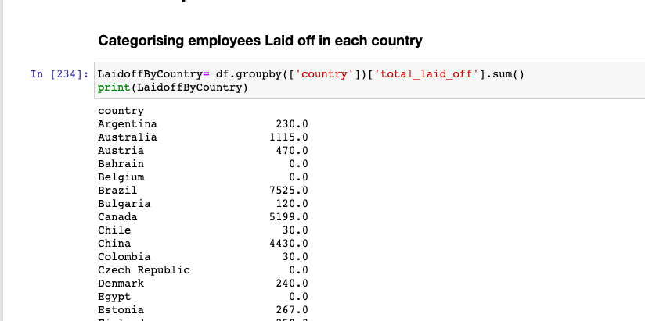
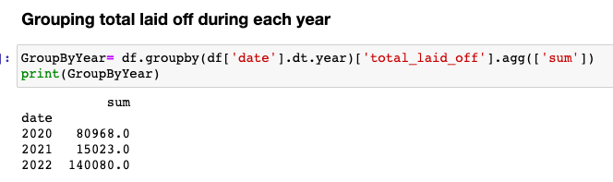
Appendix 3.1 - Data Manipulation
Determining the total number of employees laid off in the year 2020, 2021 and 2022
Total number of employees laid off in each country

Slide 13
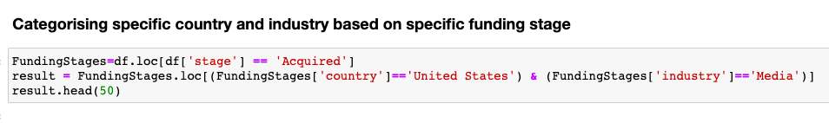
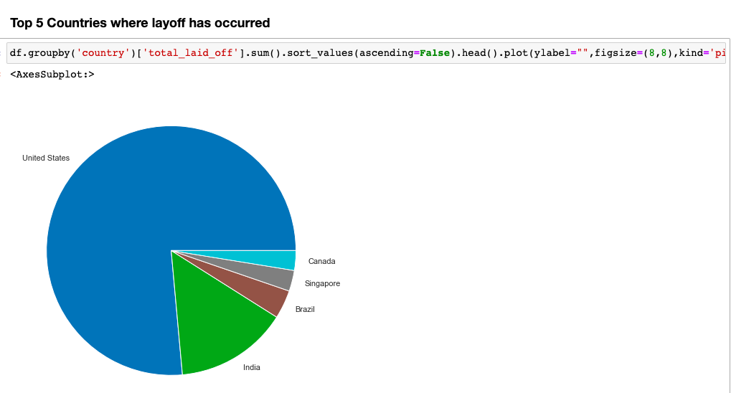
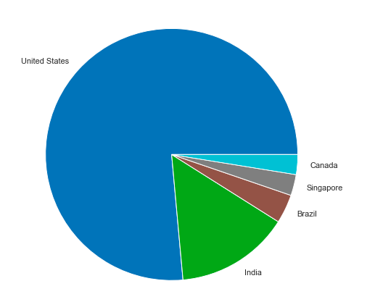
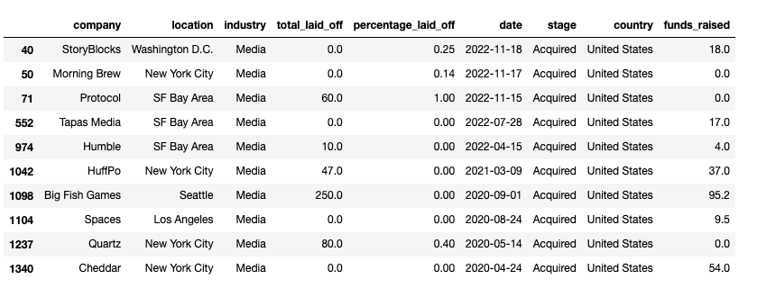
Appendix 3.2 - Data Manipulation Cont.
Grouping funding stage based on particular country and industry
Top 5 nations where layoffs have taken place

Slide 14
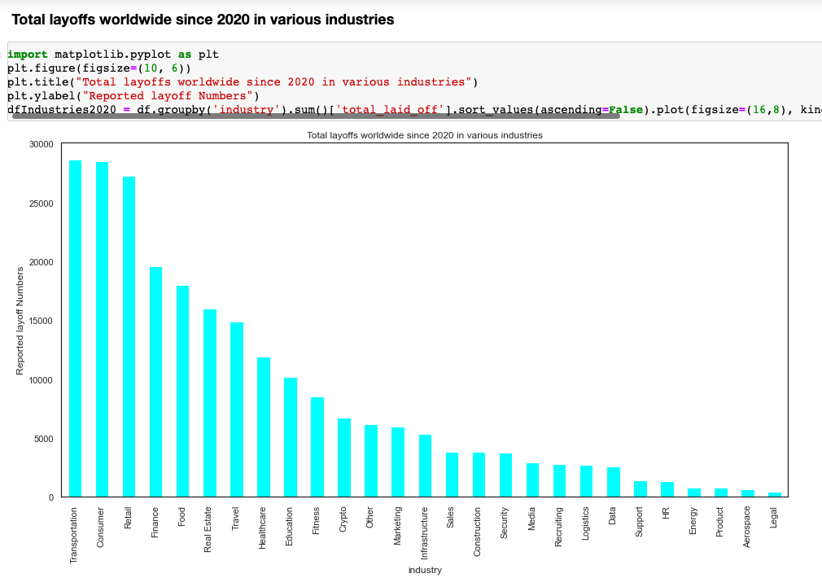
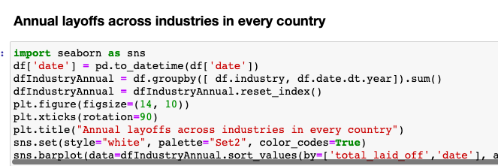
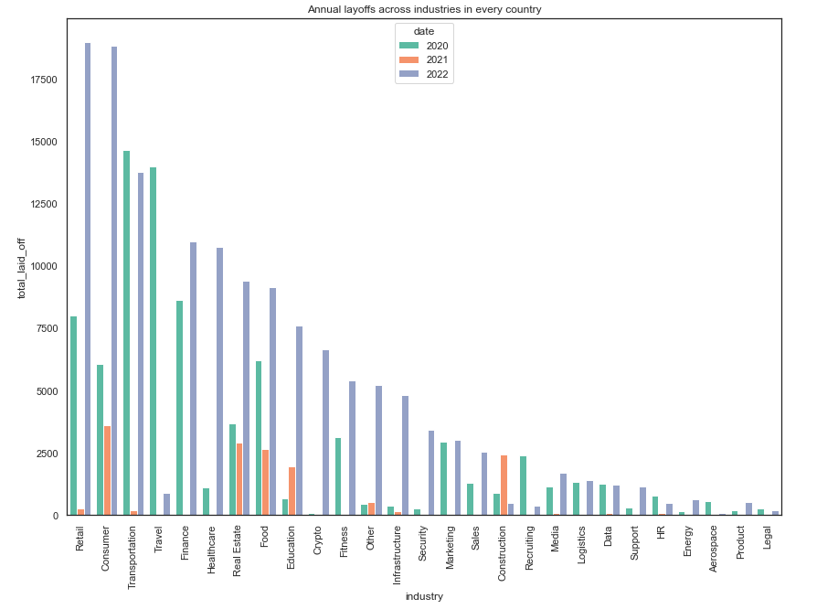
Appendix 3.3 - Data Manipulation cont.
Total global layoffs since 2020 across various industries
Annual layoffs in tech industries in all countries

Slide 15
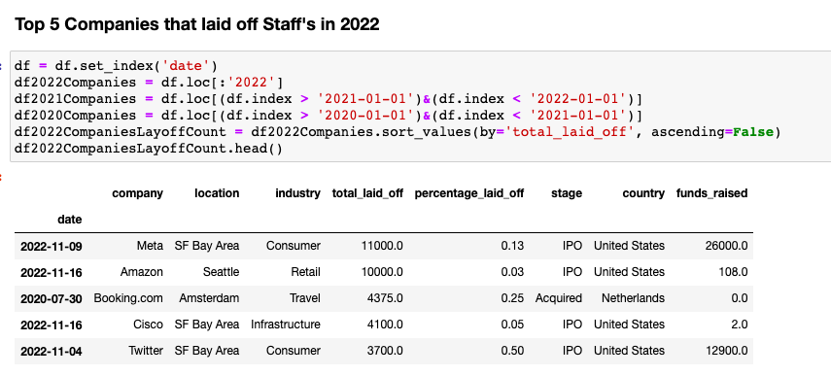
Appendix 3.4 - Data Manipulation Cont.
Top 5 Companies Laying Off Employees in 2022

Slide 16

Thank You !!

